Slide 1



HACKATHON
PRESENTATION
PRESENTED BY: Team DataFlow

Slide 2



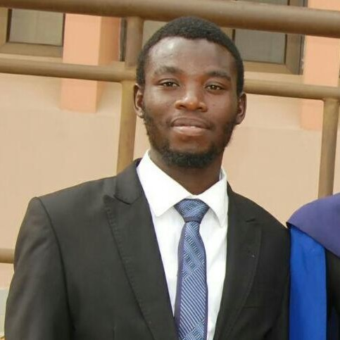

ABOUT US
Adedoyin Ajeyomi
Adegboyega Oluwagbemiga
The DataFlow team comprises of 4 Data Engineers (as depicted)
Hammed Akin AROGUNDADE
Adegunju Hammed

Slide 3

OUR PROJECT
This project involves extracting country data from a public REST API, transforming the data, loading it into a database, and analyzing it to gain insights.
The data is used to answer specific analytical questions and visualize the results in a dashboard.
Our project is aimed at developing a data pipeline with a simple architecture that could be running by anyone and a final Visualization Dashboard

Slide 4
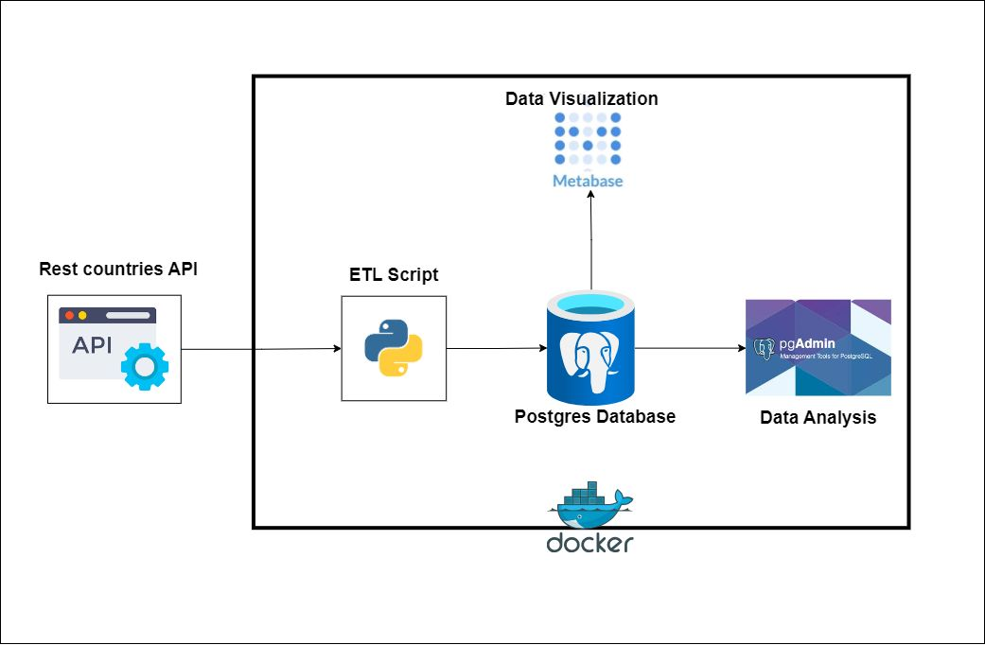
ARCHITECTURE
Component | Description
Data Source | REST API
Python | Extraction, Transformation, and Load (ETL)
Metabase | Visualization
PgAdmin | IDE to access Database
Postgres | Data Warehouse
Docker | Container

Slide 5
PROCESS
RUNNING WITHOUT DOCKER
Make sure you have Pgadmin and Postgres on your PC.
Clone the repository.
git clone https://github.com/SammyGIS/dec-hackathon-team-1-solution.git
3. Install required dependencies.
pip install -r requirements.txt
4. Run the script in the CLI to extract, transform, and load the data into the database.
python etl_script.py
You can then perform your analysis in PgAdmin.You can also connect it to postgress installed on your PC.
All you need to do is add the host, port, password, and default database name in the .env file.

Slide 6
RUNNING WITH DOCKER
This is the best way to enjoy what we built. This way, all systems are connected seamlessly. If you're on Windows, you can install Docker from Docker Hub.
Start Docker on your CLI.
Clone the repository.
git clone https://github.com/SammyGIS/dec-hackathon-team-1-solution.git
To address issues of conflicting ports, you can clear any running containers or change the port in the docker-compose.yaml file.
Open your cli, chnage to the directory you cloned in step 2, build the Docker images uisng the command.
docker-compose build
Run the containers in detached mode.
docker-compose up –d
This automatically runs all the processes defined in the workflow. You can access your Pgadmin via localhost:8080 to running your query or connect your pgdatabase to metabase and run metabase visualization app via localhost:3000.

Slide 7
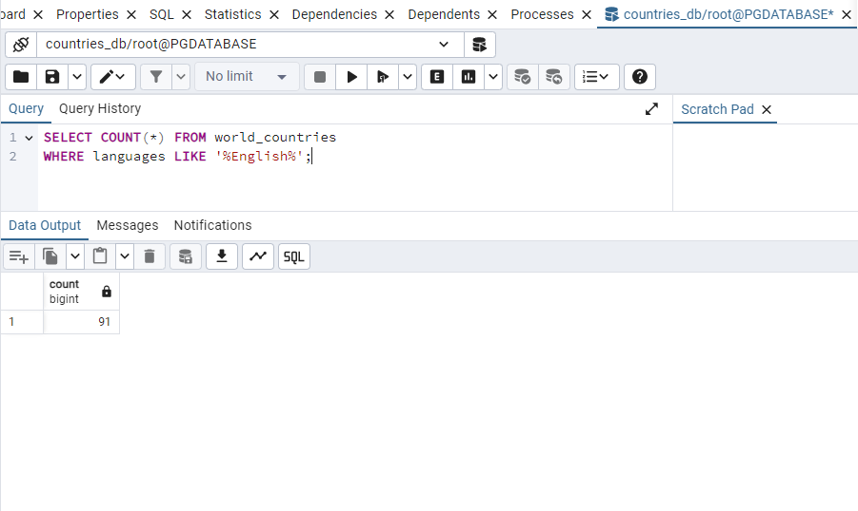
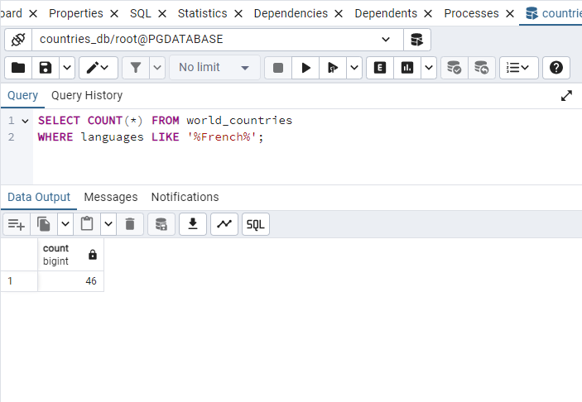
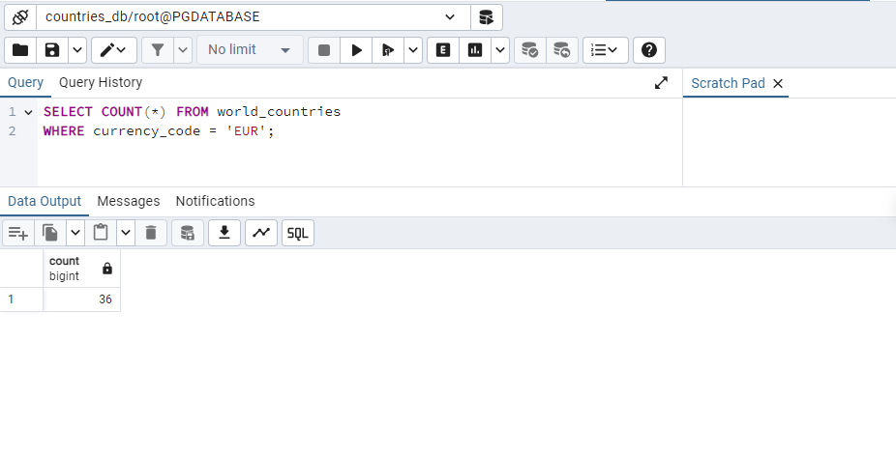
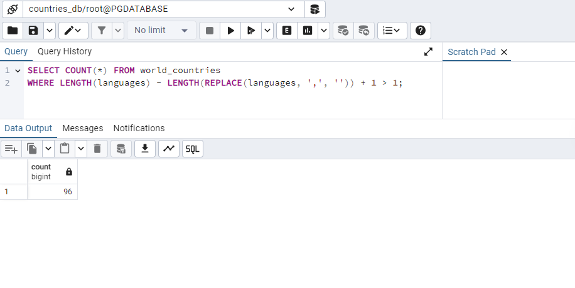
ANALYTICS

Slide 8
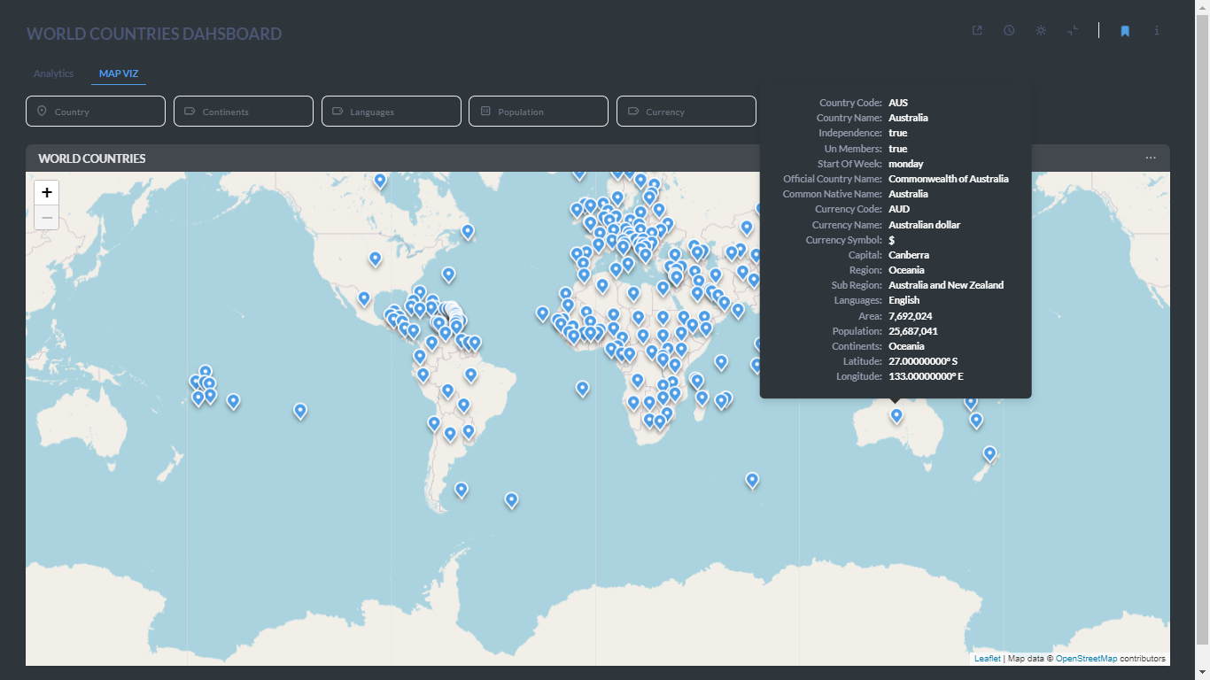
DASHBOARD USING METABASE
Map Viz

Slide 9
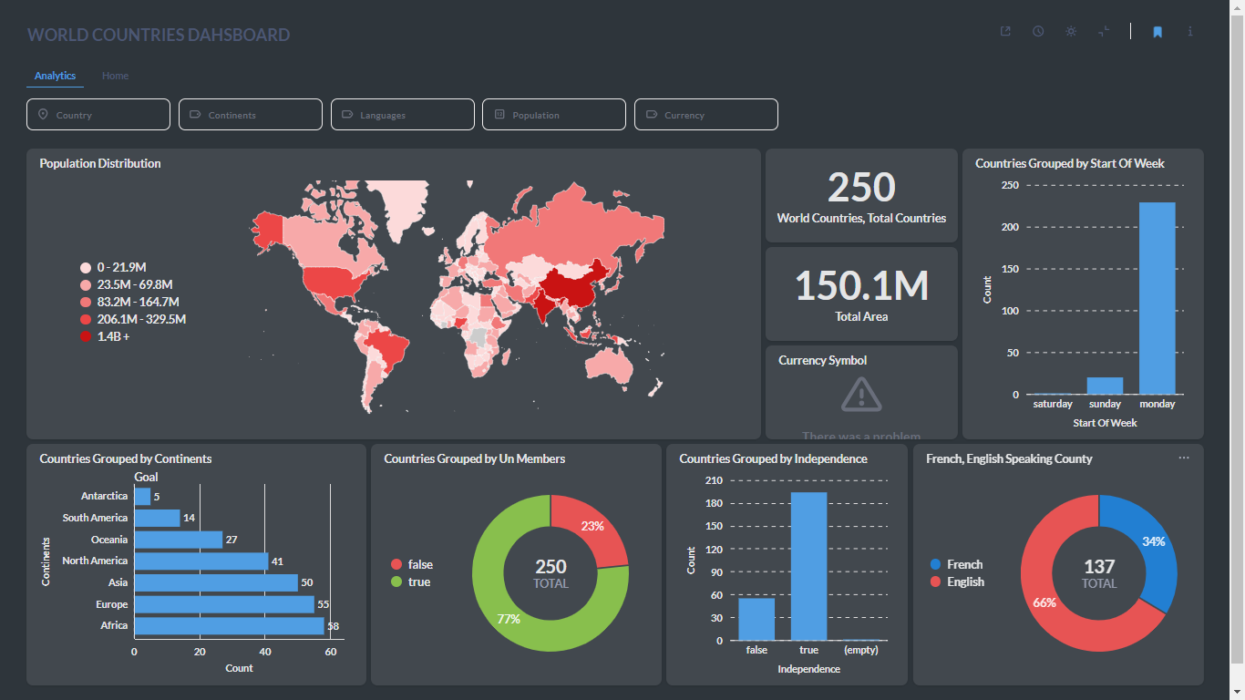
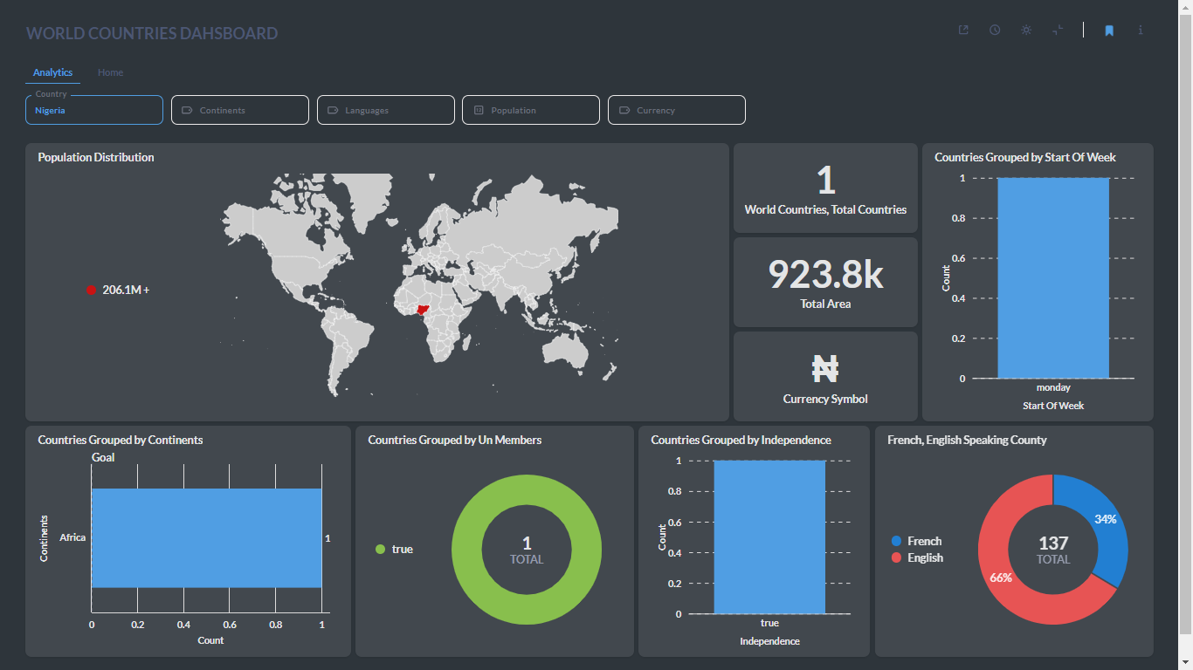
DASHBOARD USING METABASE
ANALYTICS PAGE
QUERY: Nigeria

Slide 10
OVERVIEW OF THE PROJECT REPO/DEMO

Slide 11
LESSON LEARNT
CHALLENGES
The most challenging part was ensuring everything worked seamlessly. We coordinated through short meetings and daily chats on Discord to make sure everything ran smoothly.
Team Collaboration
Time Management
To fork the repo or replicate what we did:
https://github.com/SammyGIS/dec-hackathon-team-1-solution

Slide 12
THANK YOU

